Slide 1
Odoo Upgrade - Progress Reporting
June [21 to 25]

Slide 2

Overview

Slide 3
Overview
Project Documents and References:
Project Plan link:
https://docs.google.com/spreadsheets/d/18ZDAdHBzsEPdpr6rOwJDw2ViElgeVGW-ovWh-N8FheQ/edit?usp=sharing
Functional Test cases document:
https://docs.google.com/spreadsheets/d/12t1AjhoWo4CEOnC9snuApc7Y9-KMogo06I3qzkV-VHQ/edit?usp=sharing
UAT and Complete QA planning:
https://docs.google.com/spreadsheets/d/1zogqMJEMYcj1Ipb8xfOZKy1jcYYzcgeYiMnl-DUolIM/edit?usp=sharing
General action Items tracking sheet: https://docs.google.com/spreadsheets/d/1CQK9vK6pHrssCAB1glM9QhZQiUsD6ni9HpDKusIilDs/edit?usp=sharing

Slide 4
Progress Report -(June 14 - 18)

Slide 5
Progress Report Summary - (June 21-25)
Week Highlights:
Modules Migration [By Verts Team]
Saarus:
Competed Saarus ERP Code Migration [1 Module is in progress].
KNK:
Completed the Migration of 80% of KNK Finance Modules
Completed KNK Finance dependent modules 90 % [14 Modules]
Overall KNK Migration [35% done]
Functional Test cases completion:
KOKO QA team working on the Performance testing strategy.
Uday will be working on the Scripts of the Load and Performance testing. [So that after migration we can see a comparative study of performance between both Odoo Versions]
Next Week Plan and Highlights: [June 21 -25]
Modules Migration [By Verts Team]
Complete Testing of Saarus Modules and Issue fixes found in the testing.
Saarus Demo to scheduled early next week. [Tuesday]
Complete Migration of KNK Finance Modules and handover and start migrating rest of the KNK modules.
Completion of the Migration of Finance Dependent modules [Which are non Finance]
Testing:
Verts team to complete one level of testing for the KNI Modules and then KOKO QA team will start on the Functional testing for the same. will be comnitue to the next week as some bugs were found in initial testing.
Documentation:
Verts Team to share the scope of improvements found in Saarus Migration. [Module wise or functionality wise]
Verts Team to share the scope of improvements points found in KNK Finance Migration Migration so far.

Slide 6
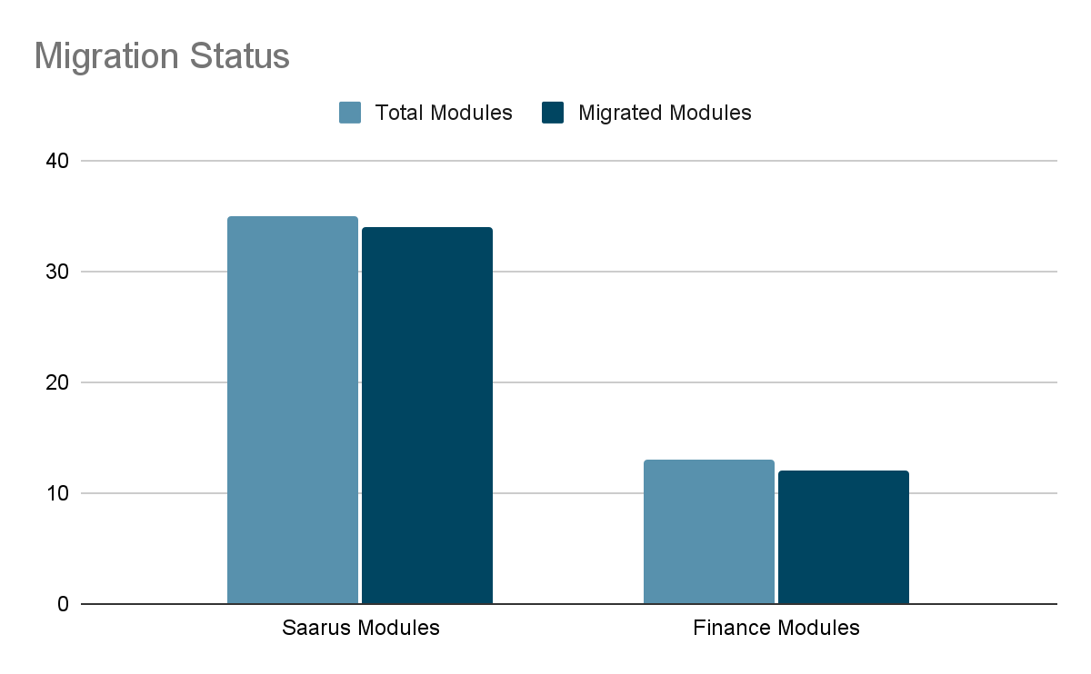
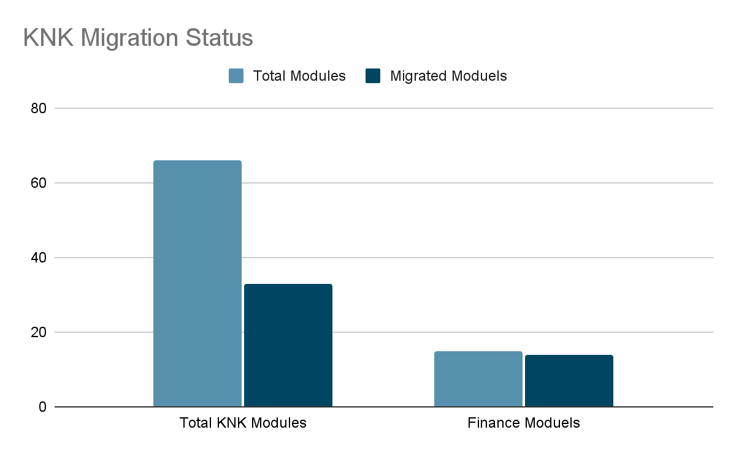
Progress Analysis
Saarus Code Migration Status
KNK Code Migration Status

Slide 7
Risks and Issue
Nothing Found during this week.

Slide 8
Madhav Agarwal
m.agarwal@kokonetworks.com

